Slide 1
Patch Management with SD-UX
Version A.01
H3064S Module 20 Slides

Slide 2
Why Install Patches?
New functionality
New hardware support
Bug fixes
a669103

Slide 3
Patch Naming Conventions
Patch Name Format is: PHxx_yyyy
where:
  PH = Patch HP-UX.
  xx = area patched:
      CO - general HP-UX commands.
      KL - kernel patches.
      NE - network specific patches.
      SS - all other subsystems: X11, Starbase, etc.
  yyyy = a unique number
Example: PHSS_4014 - an HP-UX subsystem patch name.
a669138

Slide 4
Obtaining Patches
HP Electronic Support Center (ESC)
  individual patches
  custom patch manager
The Extension Software (XSW) CD-ROM
HP Enterprise Response Centers
  custom patch tapes
a669104

Slide 5
Retrieving Patches from the Web Patch Database
PHKL_6681.text
PHKL_6681.depot
PHKL_6681 shar archive
1 Back up system
2 Download patch from the ESC web site to /tmp
3 cd /tmp
4 sh PHKL_6681
5 more PHKL_6681.text
6 swinstall -s PHKL_6681.depot
a669105

Slide 6

Retrieving Patches from Tape or CD
1. Do a full backup.
2. mkdir /patchCD
3. mount /dev/dsk/cxtxdx /patchCD
4. swinstall -s /patchCD
S/W Extension
CD
1. Do a full backup.
2. swinstall -s /dev/rmt/0m
Depot Format
Patch Tape
a669106

Slide 7
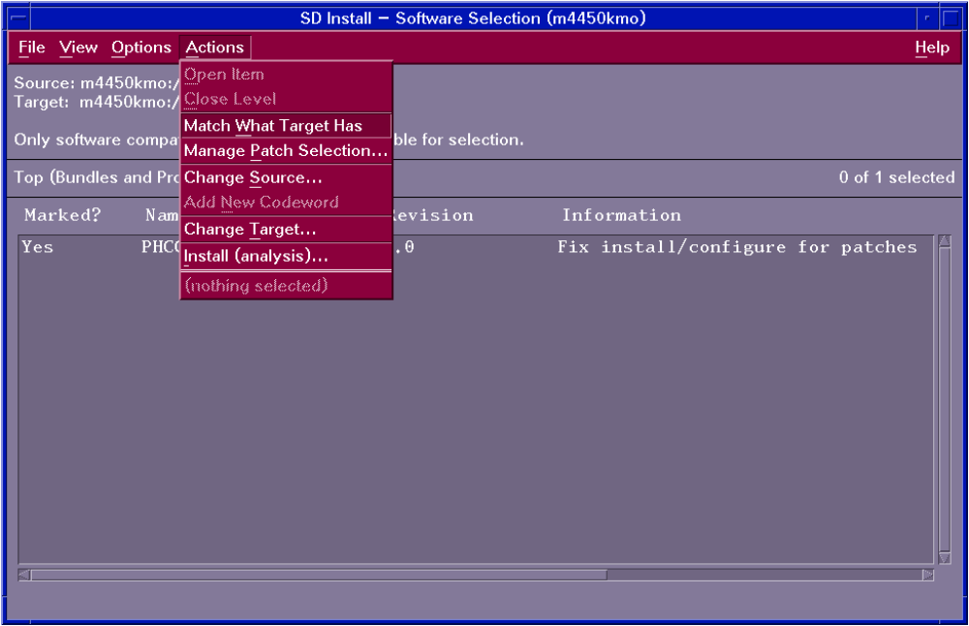
Installing Patches with swinstall
a669107

Slide 8
Listing Patches
11.00
    swlist -l patch ’*.*, c=patch’
10.x
    swlist -l product PH*
a669108

Slide 9
Removing Patches
11.0
Target
System
Product
Patch
Before
After
11.0
Target
System
Product
swremove PHKL_1234
Saved Files
a669109

